Slide 1
Examples’ Source Code
Source Code for examples presented in these slides can be found on:
Blackboard->Course Content->Source Code Of The Book Examples

Slide 2
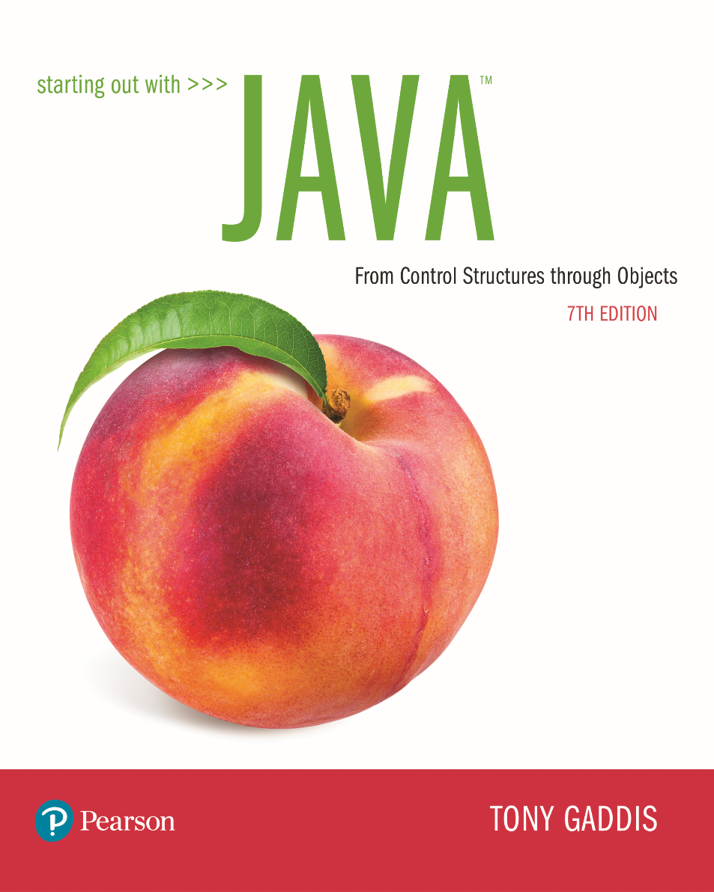

Slide 3
Module 15 Topics
Module 15 discusses the following main topics:
9.1 - Introduction to Wrapper Classes
9.2 - Character Testing and Conversion with the Character Class
9.3 - More String Methods
9.4 - The StringBuilder Class
9.5 - The StringTokenizer Class
9.6 - Wrapper Classes for the Numeric Data Types
9.7 - Focus on Problem Solving: The TestScoreReader Class

Slide 4
Introduction to Wrapper Classes
Java provides 8 primitive data types.
They are called “primitive” because they are not created from classes.
Java provides wrapper classes for all of the primitive data types.
A wrapper class is a class that is “wrapped around” a primitive data type.
The wrapper classes are part of java.lang so to use them, there is no import statement required.

Slide 5
Wrapper Classes
Wrapper classes allow you to create objects to represent a primitive.
Wrapper classes are immutable, which means that once you create an object, you cannot change the object’s value.
To get the value stored in an object you must call a method.
Wrapper classes provide static methods that are very useful

Slide 6
Character Testing and Conversion With The Character Class
The Character class allows a char data type to be wrapped in an object.
The Character class provides methods that allow easy testing, processing, and conversion of character data.

Slide 7
The Character Class
Method | Description
boolean isDigit( char ch) | Returns true if the argument passed into ch is a digit from 0 through 9. Otherwise returns false.
boolean isLetter( char ch) | Returns true if the argument passed into ch is an alphabetic letter. Otherwise returns false.
boolean isLetterOrDigit( char ch) | Returns true if the character passed into ch contains a digit (0 through 9) or an alphabetic letter. Otherwise returns false.
boolean isLowerCase( char ch) | Returns true if the argument passed into ch is a lowercase letter. Otherwise returns false.
boolean isUpperCase( char ch) | Returns true if the argument passed into ch is an uppercase letter. Otherwise returns false.
boolean isSpaceChar( char ch) | Returns true if the argument passed into ch is a space character. Otherwise returns false.

Slide 8
Character Testing and Conversion With The Character Class
Example:
CharacterTest.java
CustomerNumber.java
The Character class provides two methods that will change the case of a character.
Method | Description
char toLowerCase( char ch) | Returns the lowercase equivalent of the argument passed to ch.
char toUpperCase( char ch) | Returns the uppercase equivalent of the argument passed to ch.
See example: CircleArea.java

Slide 9
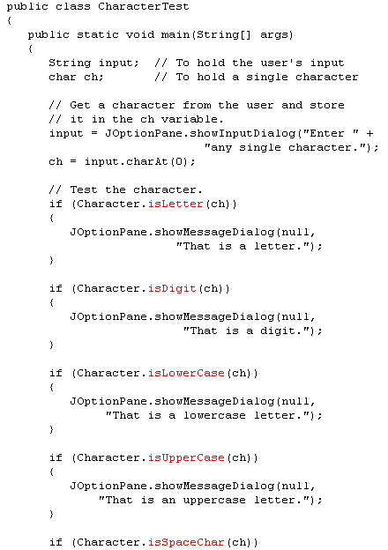

Slide 10
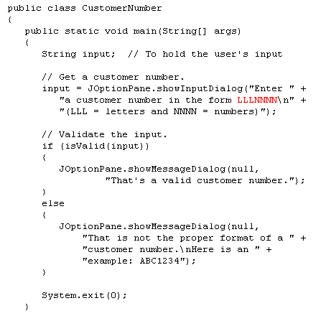
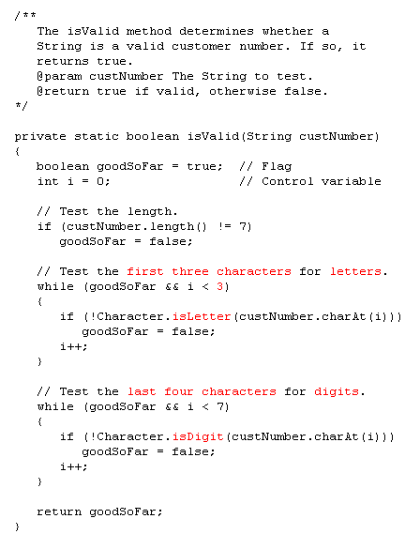

Slide 11
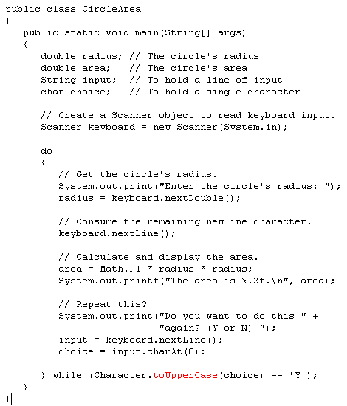
What is the purpose of
Using the toUpperCase here?
to use a y or Y

Slide 12
Substrings
The String class provides several methods that search for a string inside of a string.
A substring is a string that is part of another string.
Some of the substring searching methods provided by the String class:
boolean startsWith(String str)
boolean endsWith(String str)
boolean regionMatches(int start, String str, int start2, int n)
boolean regionMatches(boolean ignoreCase, int start, String str, int start2, int n)

Slide 13
Searching Strings
The startsWith method determines whether a string begins with a specified substring.
String str = "Four score and seven years ago";
if (str.startsWith("Four"))
System.out.println("The string starts with Four.");
else
System.out.println("The string does not start with Four.");
str.startsWith("Four") returns true because str does begin with “Four”.
startsWith is a case sensitive comparison.

Slide 14
Searching Strings
The endsWith method determines whether a string ends with a specified substring.
String str = "Four score and seven years ago";
if (str.endsWith("ago"))
System.out.println("The string ends with ago.");
else
System.out.println("The string does not end with ago.");
The endsWith method also performs a case sensitive comparison.
Example: PersonSearch.java

Slide 15
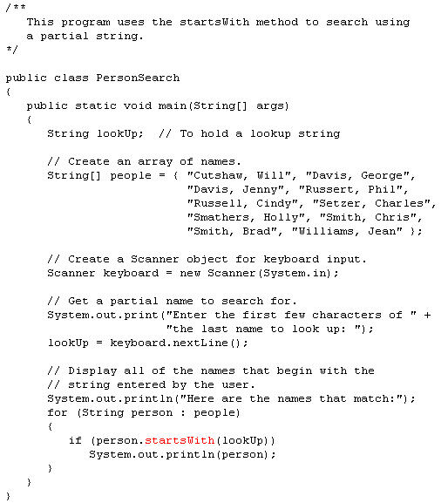
What would be printed if lookup was “Sm”?
Smathers, Holly
Smith, Chris
Smith, Brad

Slide 16
Searching Strings
The String class provides methods that will if specified regions of two strings match.
regionMatches(int start, String str, int start2, int n)
returns true if the specified regions match or false if they don’t
Case sensitive comparison
regionMatches(boolean ignoreCase, int start, String str, int start2, int n)
If ignoreCase is true, it performs case insensitive comparison

Slide 17
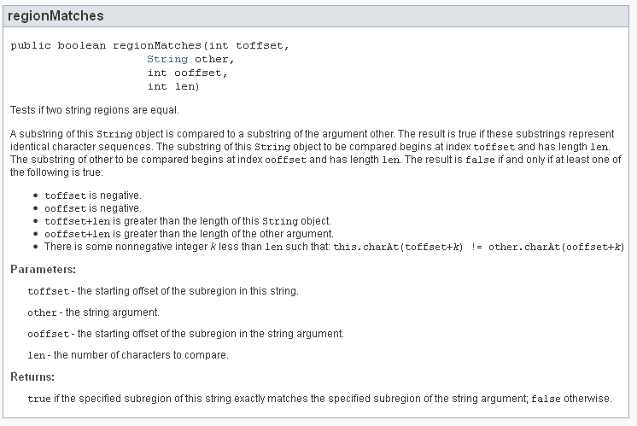
string str1 = “Hello, Bob”;
string str2 = “Bob is cool”;
str1.regionMatches(7, str2, 0, 3); would return true;

Slide 18
Searching Strings
The String class also provides methods that will locate the position of a substring.
indexOf
returns the first location of a substring or character in the calling String Object.
lastIndexOf
returns the last location of a substring or character in the calling String Object.

Slide 19
Searching Strings
String str = "Four score and seven years ago";
int first, last;
first = str.indexOf('r');
last = str.lastIndexOf('r');
System.out.println("The letter r first appears at "
+ "position " + first);
System.out.println("The letter r last appears at "
+ "position " + last);
String str = "and a one and a two and a three";
int position;
System.out.println("The word and appears at the "
+ "following locations.");
position = str.indexOf("and");
while (position != -1)
{
System.out.println(position);
position = str.indexOf("and", position + 1);
}

Slide 20
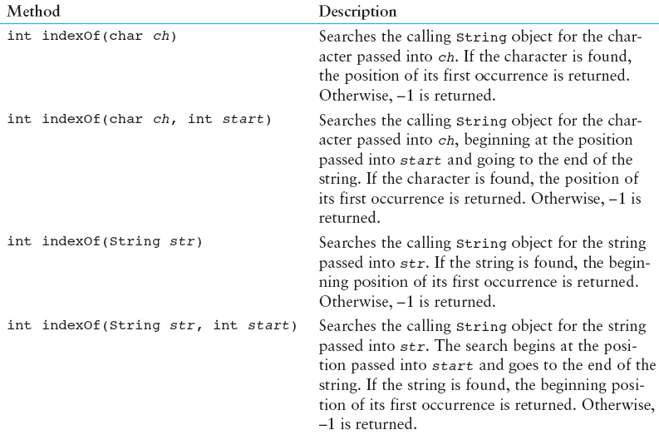
String Methods For Getting Character Or Substring Location
See Table 9-4

Slide 21
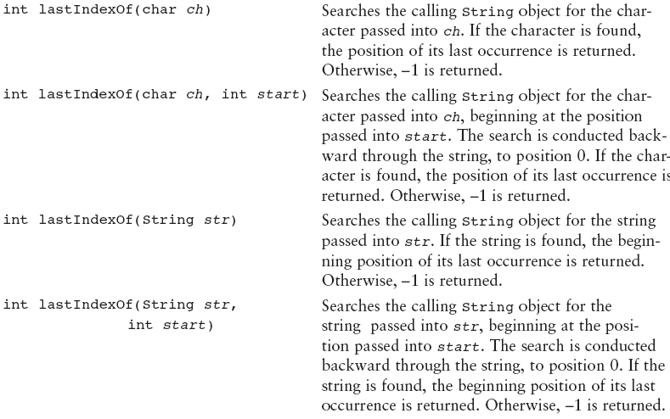
String Methods For Getting Character Or Substring Location
See Table 9-4

Slide 22
Extracting Substrings
The String class provides methods to extract substrings in a String object.
The substring method returns a substring beginning at a start location and an optional ending location.
String fullName = "Cynthia Susan Smith";
String lastName = fullName.substring(14);
System.out.println("The full name is " + fullName);
System.out.println("The last name is " + lastName);

Slide 23
Extracting Substrings
The fullName variable holds the address of a String object.
Address
“Cynthia Susan Smith”
The lastName variable holds the address of a String object.
Address
“Smith”

Slide 24
Extracting Characters to Arrays
The String class provides methods to extract substrings in a String object and store them in char arrays.
getChars
Stores a substring in a char array
toCharArray
Returns the String object’s contents in an array of char values.
Example: StringAnalyzer.java

Slide 25
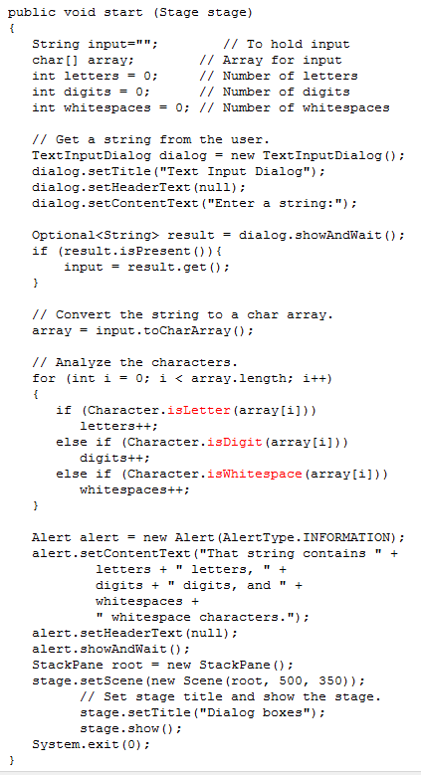
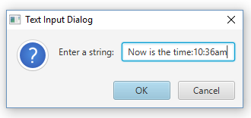
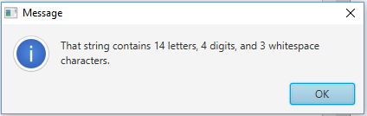

Slide 26
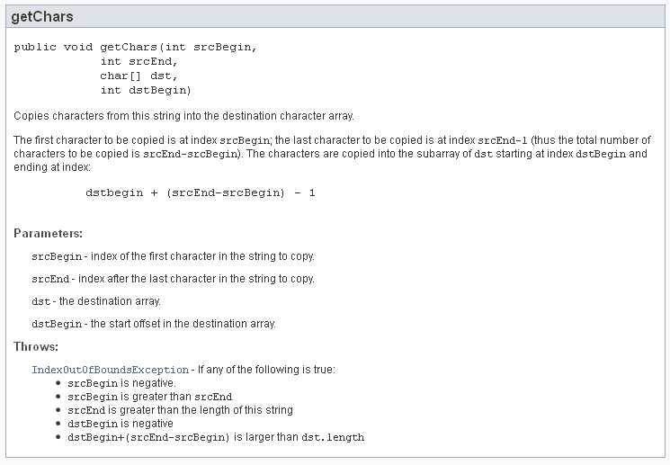
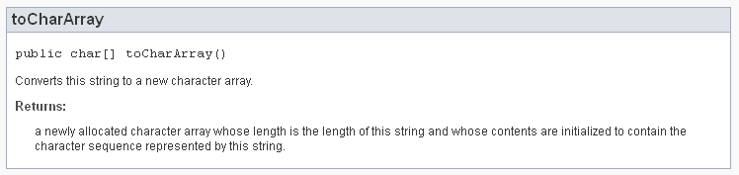

Slide 27
Returning Modified Strings
The String class provides methods to return modified String objects.
concat
Returns a String object that is the concatenation of two String objects.
replace
Returns a String object with all occurrences of one character being replaced by another character.
trim
Returns a String object with all leading and trailing whitespace characters removed.

Slide 28
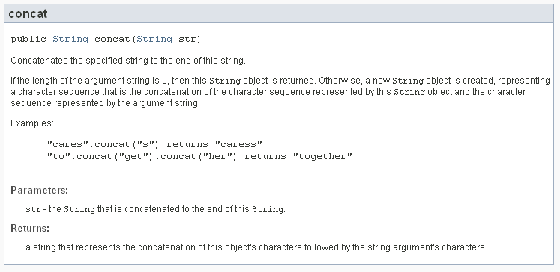
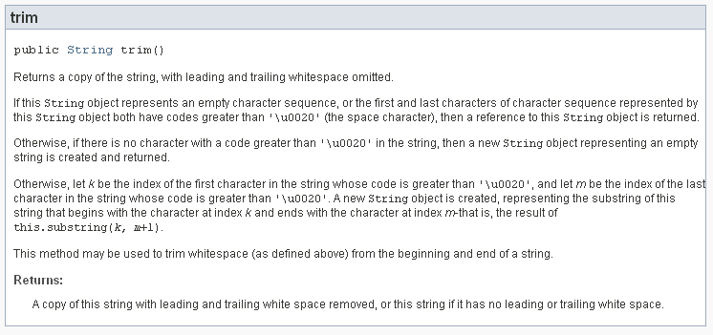

Slide 29
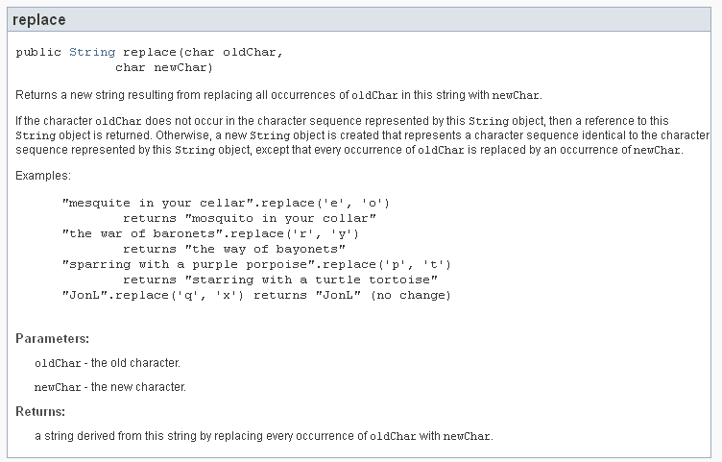

Slide 30
The valueOf Methods
The String class provides several overloaded valueOf methods.
They return a String object representation of
a primitive value or
a character array.
String.valueOf(true) will return "true".
String.valueOf(5.0) will return "5.0".
String.valueOf(‘C’) will return "C".

Slide 31
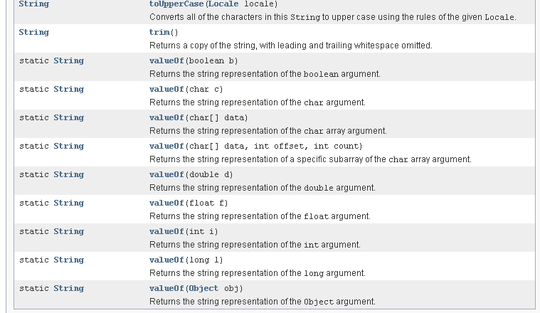
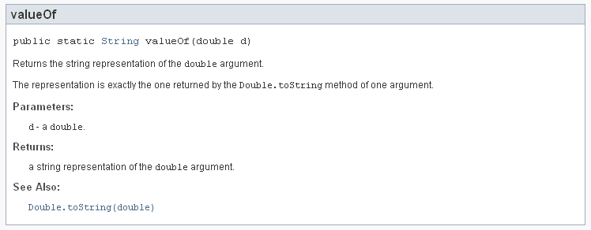

Slide 32
What is the output from the following?
Check the API if needed
boolean b = true;
char [] letters = { 'a', 'b', 'c', 'd', 'e' };
double d = 2.4981567;
int i = 7;
System.out.println(String.valueOf(b));
System.out.println(String.valueOf(letters));
System.out.println(String.valueOf(letters, 1, 3));
System.out.println(String.valueOf(d));
System.out.println(String.valueOf(i));
Produces the following output:
true
abcde
bcd
2.4981567
7

Slide 33
The StringBuilder Class
The StringBuilder class is similar to the String class.
However, you may change the contents of StringBuilder objects.
You can change specific characters,
insert characters,
delete characters, and
perform other operations.
A StringBuilder object will grow or shrink in size, as needed, to accommodate the changes.

Slide 34
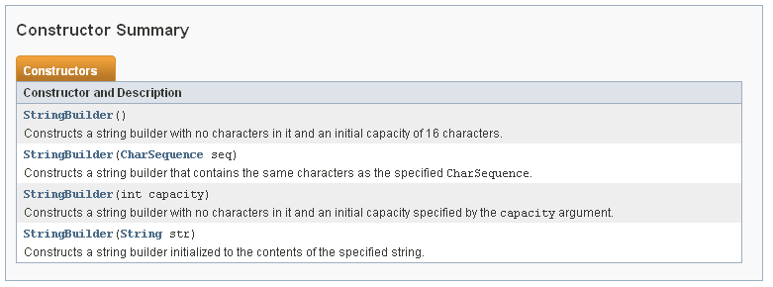
StringBuilder Constructors
StringBuilder()
This constructor gives the object enough storage space to hold 16 characters.
StringBuilder(int length)
This constructor gives the object enough storage space to hold length characters.
StringBuilder(String str)
This constructor initializes the object with the string in str.
The object will have at least enough storage space to hold the string in str.

Slide 35
Other StringBuilder Methods
The String and StringBuilder also have common methods:
char charAt(int position)
void getChars(int start, int end,
char[] array, int arrayStart)
int indexOf(String str)
int indexOf(String str, int start)
int lastIndexOf(String str)
int lastIndexOf(String str, int start)
int length()
String substring(int start)
String substring(int start, int end)

Slide 36
Appending to a StringBuilder Object
The StringBuilder class has several overloaded versions of a method named append.
They append a string representation of their argument to the calling object’s current contents.
The general form of the append method is:
object.append(item);
where object is an instance of the StringBuilder class and item is:
a primitive literal or variable.
a char array, or
a String literal or object.

Slide 37
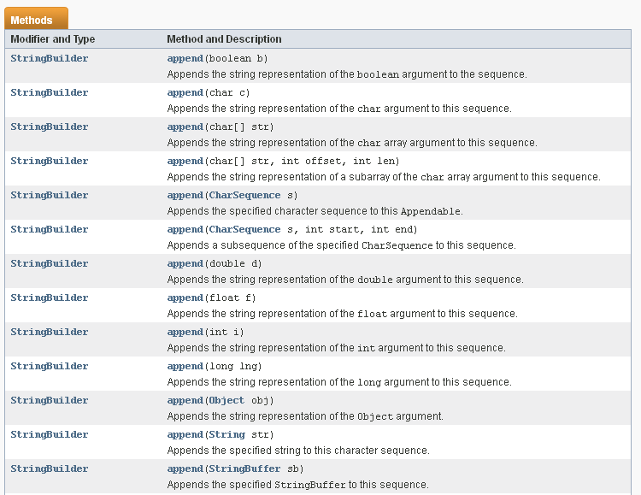

Slide 38
Appending to a StringBuilder Object
After the append method is called, a string representation of item will be appended to object’s contents.
StringBuilder str = new StringBuilder();
str.append("We sold ");
str.append(12);
str.append(" doughnuts for $");
str.append(15.95);
System.out.println(str);
This code will produce the following output:
We sold 12 doughnuts for $15.95

Slide 39
Appending to a StringBuilder Object
The StringBuilder class also has several overloaded versions of a method named insert
These methods accept two arguments:
an int that specifies the position to begin insertion, and
the value to be inserted.
The value to be inserted may be
a primitive literal or variable.
a char array, or
a String literal or object.

Slide 40
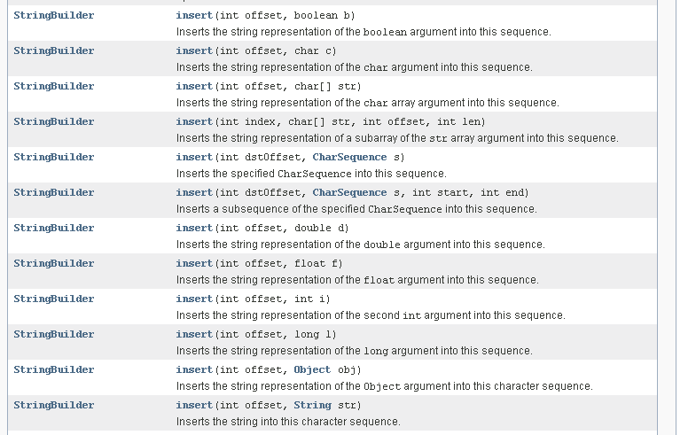
What method do you think is used here?

Slide 41
Appending to a StringBuilder Object
The general form of a typical call to the insert method.
object.insert(start, item);
where object is an instance of the StringBuilder class, start is the insertion location, and item is:
a primitive literal or variable.
a char array, or
a String literal or object.
Example: Telephone.java TelephoneTester.java

Slide 42
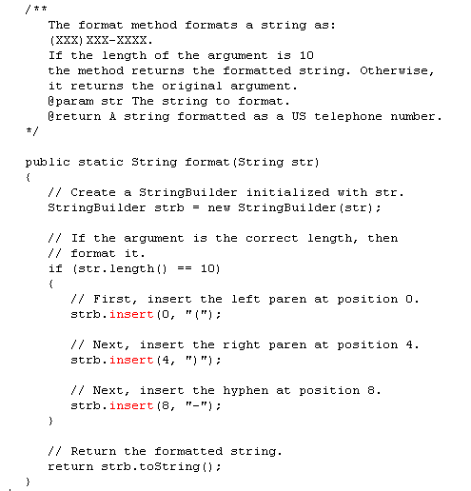

Slide 43
Replacing a Substring in a StringBuilder Object
The StringBuilder class has a replace method that replaces a specified substring with a string.
The general form of a call to the method:
object.replace(start, end, str);
start is an int that specifies the starting position of a substring in the calling object, and
end is an int that specifies the ending position of the substring. (The starting position is included in the substring, but the ending position is not.)
The str parameter is a String object.
After the method executes, the substring will be replaced with str.

Slide 44
Replacing a Substring in a StringBuilder Object
The replace method in this code replaces the word “Chicago” with “New York”.
StringBuilder str = new StringBuilder(
"We moved from Chicago to Atlanta.");
str.replace(14, 21, "New York");
System.out.println(str);
The code will produce the following output:
We moved from New York to Atlanta.

Slide 45
Other StringBuilder Methods
The StringBuilder class also provides methods to set and delete characters in an object.
StringBuilder str = new StringBuilder(
"I ate 100 blueberries!");
// Display the StringBuilder object.
System.out.println(str);
// Delete the '0'.
str.deleteCharAt(8);
// Delete "blue".
str.delete(9, 13);
// Display the StringBuilder object.
System.out.println(str);
// Change the '1' to '5'
str.setCharAt(6, '5');
// Display the StringBuilder object.
System.out.println(str);

Slide 46
Other StringBuilder Methods
The toString method
You can call a StringBuilder's toString method to convert that StringBuilder object to a regular String
StringBuilder strb = new StringBuilder("This is a test.");
String str = strb.toString();

Slide 47
The StringTokenizer Class
The StringTokenizer class breaks a string down into its components, which are called tokens.
Tokens are a series of words or other items of data separated by spaces or other characters.
"peach raspberry strawberry vanilla"
This string contains the following four tokens: peach, raspberry, strawberry, and vanilla.

Slide 48
The StringTokenizer Class
The character that separates tokens is a delimiter.
"17;92;81;12;46;5"
This string contains the following tokens: 17, 92, 81, 12, 46, and 5 that are delimited by semi-colons.
Some programming problems require you to process a string that contains a list of items.

Slide 49
The StringTokenizer Class
For example,
The process of breaking a string into tokens is known as tokenizing.
The Java API provides the StringTokenizer class that allows you to tokenize a string.
The following import statement must be used in any class that uses it:
import java.util.StringTokenizer;
a date: "4-2-2010" | an operating system pathname, /home/rsullivan/data

Slide 50
StringTokenizer Constructors
Constructor | Description
StringTokenizer( String str) | The string to be tokenized is passed into str. Whitespace characters (space, tab, and newline) are used as delimiters.
StringTokenizer( String str, String delimiters) | The string to be tokenized is passed into str. The characters in delimiters will be used as delimiters.
StringTokenizer( String str, String delimiters, Boolean returnDelimeters) | The string to be tokenized is passed into str. The characters in delimiters will be used as delimiters. If the returnDelimiters parameter is set to true, the delimiters will be included as tokens. If this parameter is set to false, the delimiters will not be included as tokens.

Slide 51
Creating StringTokenizer Objects
To create a StringTokenizer object with the default delimiters (whitespace characters):
StringTokenizer strTokenizer =
new StringTokenizer("2 4 6 8");
To create a StringTokenizer object with the hyphen character as a delimiter:
StringTokenizer strTokenizer =
new StringTokenizer("8-14-2004", "-");
To create a StringTokenizer object with the hyphen character as a delimiter, returning hyphen characters as tokens as well:
StringTokenizer strTokenizer =
new StringTokenizer("8-14-2004", "-", true);

Slide 52
StringTokenizer Methods
The StringTokenizer class provides:
countTokens
Count the remaining tokens in the string.
hasMoreTokens
Are there any more tokens to extract?
nextToken
Returns the next token in the string.
Throws a NoSuchElementException if there are no more tokens in the string.

Slide 53
What is the output from the following?
Check the API if needed
StringTokenizer strTokenizer =
new StringTokenizer("One Two Three");
while (strTokenizer.hasMoreTokens())
{
System.out.println(strTokenizer.nextToken());
}
This code will produce the following output:
One
Two
Three

Slide 54
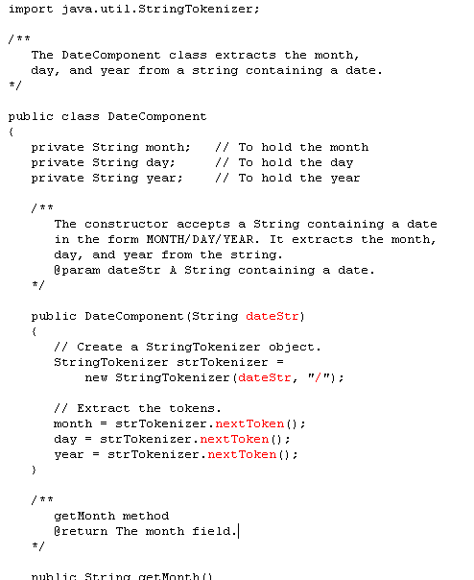

Slide 55
Multiple Delimiters
The default delimiters for the StringTokenizer class are the whitespace characters.
\n\r\t\b\f
Other multiple characters can be used as delimiters in the same string.
joe@gaddisbooks.com
This string uses two delimiters: @ and .
If non-default delimiters are used
The String class trim method should be used on user input strings to avoid having whitespace become part of the last token.

Slide 56
Multiple Delimiters
To extract the tokens from this string we must specify both characters as delimiters to the constructor.
StringTokenizer strTokenizer =
new StringTokenizer("joe@gaddisbooks.com", "@.");
while (strTokenizer.hasMoreTokens())
{
System.out.println(strTokenizer.nextToken());
}
This code will produce the following output:
joe
gaddisbooks
com

Slide 57
The String Class split Method
Tokenizes a String object and returns an array of String objects
Each array element is one token.
// Create a String to tokenize.
String str = "one two three four";
// Get the tokens from the string.
String[] tokens = str.split(" ");
// Display each token.
for (String s : tokens)
System.out.println(s);
This code will produce the following output:
one
two
three
four

Slide 58
Numeric Data Type Wrappers
Java provides wrapper classes for all of the primitive data types.
The numeric primitive wrapper classes are:
Wrapper Class | Numeric Primitive Type It Applies To
Byte | byte
Double | double
Float | float
Integer | int
Long | long
Short | short

Slide 59
Creating a Wrapper Object
To create objects from these wrapper classes, you can pass a value to the constructor:
Integer number = new Integer(7);
You can also assign a primitive value to a wrapper class object:
Integer number;
number = 7;
This is called “auto-boxing”

Slide 60
The Parse Methods
Recall from Chapter 2, we converted String input into numbers. Any String containing a number, such as “127.89”, can be converted to a numeric data type.
Each of the numeric wrapper classes has a static method that converts a string to a number.
The Integer class has a method that converts a String to an int,
The Double class has a method that converts a String to a double,
etc.
These methods are known as parse methods because their names begin with the word “parse.”

Slide 61
The Parse Methods
// Store 1 in bVar.
byte bVar = Byte.parseByte("1");
// Store 2599 in iVar.
int iVar = Integer.parseInt("2599");
// Store 10 in sVar.
short sVar = Short.parseShort("10");
// Store 15908 in lVar.
long lVar = Long.parseLong("15908");
// Store 12.3 in fVar.
float fVar = Float.parseFloat("12.3");
// Store 7945.6 in dVar.
double dVar = Double.parseDouble("7945.6");
The parse methods all throw a NumberFormatException if the String object does not represent a numeric value.

Slide 62
The toString Methods
Each of the numeric wrapper classes has a static toString method that converts a number to a string.
The method accepts the number as its argument and returns a string representation of that number.
int i = 12;
double d = 14.95;
String str1 = Integer.toString(i);
String str2 = Double.toString(d);

Slide 63
The toBinaryString, toHexString, and toOctalString Methods
The Integer and Long classes have three additional methods:
toBinaryString, toHexString, and toOctalString
int number = 14;
System.out.println(Integer.toBinaryString(number));
System.out.println(Integer.toHexString(number));
System.out.println(Integer.toOctalString(number));
This code will produce the following output:
1110
e
16

Slide 64
MIN_VALUE and MAX_VALUE
The numeric wrapper classes each have a set of static final variables
MIN_VALUE and
MAX_VALUE.
These variables hold the minimum and maximum values for a particular data type.
System.out.println("The minimum value for an "
+ "int is "
+ Integer.MIN_VALUE);
System.out.println("The maximum value for an "
+ "int is "
+ Integer.MAX_VALUE);

Slide 65
Autoboxing and Unboxing
You can declare a wrapper class variable and assign a value:
Integer number;
number = 7;
You nay think this is an error, but because number is a wrapper class variable, autoboxing occurs.
Unboxing does the opposite with wrapper class variables:
Integer myInt = 5; // Autoboxes the value 5
int primitiveNumber;
primitiveNumber = myInt; // unboxing

Slide 66
Autoboxing and Unboxing
You rarely need to declare numeric wrapper class objects, but they can be useful when you need to work with primitives in a context where primitives are not permitted
Recall the ArrayList class, which works only with objects.
ArrayList<int> list =
new ArrayList<int>(); // Error!
ArrayList<Integer> list =
new ArrayList<Integer>(); // OK!
Autoboxing and unboxing allow you to conveniently use ArrayLists with primitives.

Slide 67
Problem Solving
Dr. Harrison keeps student scores in an Excel file. This can be exported as a comma separated text file. Each student’s data will be on one line. We want to write a Java program that will find the average for each student. (The number of students changes each year.)
Solution: TestScoreReader.java, TestAverages.java

Slide 68
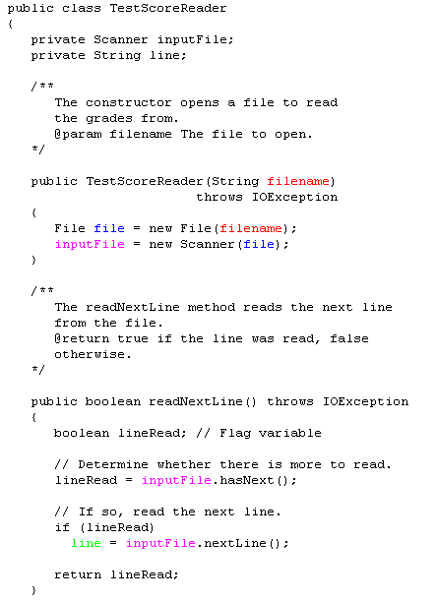
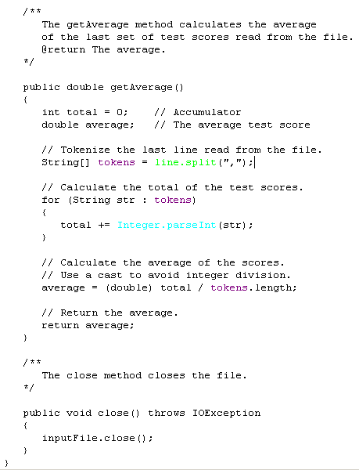

Slide 69
